Slide 1


Green Pace
Security Policy Presentation
Developer: Michael Smith

Slide 2

OVERVIEW: DEFENSE IN DEPTH
This policy aims to establish core security principles; C/C++ coding standards; authorization, authentication, and auditing standards; and data encryption standards. By doing so, we at Green Pace
hope to maintain a multi-layered defense
with our security principles by defining
what it means to have defense-in-depth.
This policy introduces proposed auto-
mation tools to more efficiently integrate
secure coding practices into the design
process.

Slide 3
THREATS MATRIX
Likely: Any coding standard that is highly susceptible to occurring
Priority: A coding standard that has a probable likelihood of occurring with at least a moderate severity
Low Priority: A coding standard that has a probable likelihood of occurring with a low severity
Unlikely: Any coding standard that is unlikely to occur
Likely STD-003-CPP STD-004-CPP STD-005-CPP | Priority STD-002-CPP STD-010-CPP
Low priority STD-007-CPP | Unlikely STD-001-CPP STD-006-CPP STD-008-CPP STD-009-CPP

Slide 4
10 PRINCIPLES
1. Validate Input Data: STD-003-CPP, STD-004-CPP
2. Heed Compiler Warnings: STD-001-CPP, STD-002-CPP, STD-005-CPP, STD-009-CPP
3. Architect and Design: STD-006-CPP
4. Keep It Simple: STD-002-CPP, STD-008-CPP, STD-009-CPP
5. Default Deny: STD-008-CPP
6. Adhere to the Principle of Least Privilege: STD-007-CPP
7. Sanitize Data Sent to Other Systems: STD-004-CPP
8. Practice Defense in Depth: STD-007-CPP
9. Use Effective Quality Assurance Techniques: STD-005-CPP, STD-006-CPP, STD-010-CPP
10. Adopting the Secure Coding Standard: STD-009-CPP

Slide 5
CODING STANDARDS
Label | Coding Standard
STD-003-CPP | String Correctness
STD-004-CPP | SQL Injection
STD-005-CPP | Memory Protection
STD-002-CPP | Data Value
STD-010-CPP | Function Returns
STD-007-CPP | Exceptions
STD-001-CPP | Data Type
STD-006-CPP | Assertions
STD-008-CPP | File Stream
STD-009-CPP | Namespaces
The following coding standards are ordered by highest priority to least priority. This was determined by using the threat matrix, established by the proposed likelihood of occurrence and severity of incident.

Slide 6
ENCRYPTION POLICIES
Encryption at rest | Encryption at rest applies to data that is not currently being, rather being stored in a server or database. A secure hashing algorithm must be implemented to keep user information that is being stored within our services safe.
Encryption in flight | Encryption in flight would be indicative of data being transferred between a database and a network/program. This policy maintains that user information shall be encrypted during the exchange of data as to mitigate man-in-the-middle attacks.
Encryption in use | Encryption in use refers to data that is actively being processed from a user. For example, when a user enters their credit card information into a web-page. Encryption of the user’s card information should take place and handled with third-party services, the information should never be stored locally to the program.

Slide 7
TRIPLE-A POLICIES
Authentication | All users using our software must be authenticated before use. This aids in reducing the possibility of users pirating our software. Also, this ensures that the person attempting to access the software is the user stated. This can be achieved with two-step verification processes.
Authorization | Users should only be allowed to conduct the operations necessary for them. For example, a common user should be able to adjust read and write privileges of themself or other users in the database. Authorization should occur after the user has been authenticated.
Accounting | Every access to our software should be logged and monitored. The types of files accessed by users should also be logged to ensure that correct functionality for that user level is still maintaining its effectiveness. Abnormalities in login behaviors should be flagged, as it could prevent a possible brute-force attack.

Slide 8
Unit Testing
The following slides contain images from the unit testing conducted on two of coding vulnerabilities described in the security policy. These coding vulnerabilities pertain to detecting errors when getting an invalid input from user and to not handling all exceptions. A mix of positive and negative tests will be demonstrated.

Slide 9
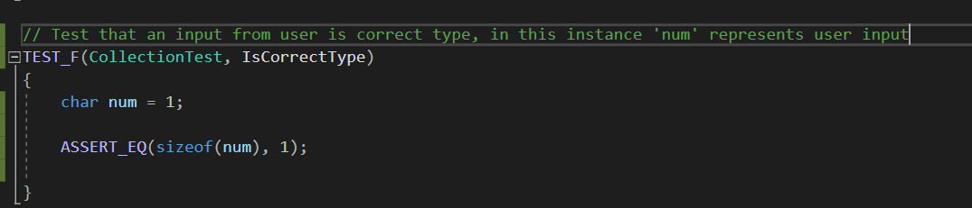
Detect errors when getting an invalid input from user
Test 1: Positive test that ensures a users’ input matches the expected object type.

Slide 10
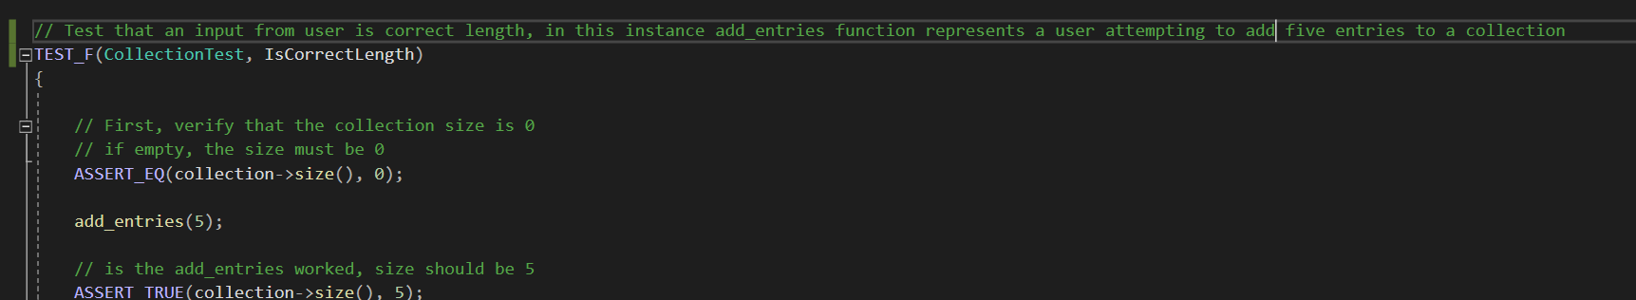
Detect errors when getting an invalid input from user
Test 2: Positive test that ensures that a user accurately increases the size of a collection based on input.

Slide 11
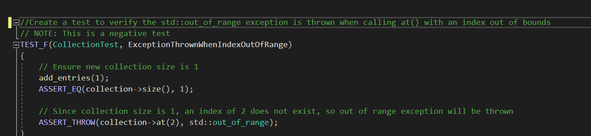
Handle all exceptions
Test 3: Negative test that asserts that an exception is thrown when an out of range exception is encountered.

Slide 12
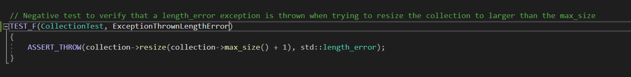
Handle all exceptions
Test 4: Negative test that asserts that an exception will be thrown when a length error is encountered.

Slide 13

AUTOMATION SUMMARY

Slide 14
TOOLS
During the verify and test phase of the DevSecOps process is where automation of the standards in this policy should be implemented. Within that phase, static testing tools can be used to guarantee that the code being developed is in line with the standards set forth by this policy. Also, during the build phase of the process developers can adhere to best practices outlined in this policy as well to mitigate time spent debugging after the automation process.
Tool | Use Cases
Google Test | Assertions
Cppcheck | Automatic variable checking, file stream handling, exception safety, memory leaks, bounds checking

Slide 15
RISKS AND BENEFITS
The current problem surrounding our development process is security measures being considered an afterthought.
The solution is to integrate secure coding best practices throughout the entire SDLC.
The risk of waiting too long to implement security measures means potentially releasing vulnerable and exploitable code to production, which could tarnish the company name depending on the impact.
Benefits of automating parts of the security layer set forth by this policy includes more efficient developing and less time spent debugging.
In a CI/CD environment, speed and efficiency is of the utmost concern, so secure code should be implemented early on (Vijayan, 2022). A key step forward would be to integrate as many automated tools as feasibly and reasonably possible.
6 DevSecOps best practices: Automate early and often | TechBeacon

Slide 16
RECOMMENDATIONS
My recommendation is to find more automated tools to increase workflow and to cover more bases. Specifically, find tools that test for interactions between servers and clients, and how that data is being transmitted to ensure encryption is taking place at every step.
Train developers and testers on this new security policy, make sure everyone is comfortable and understands the changes being implemented. Questions should be addressed promptly.
Never stop adapting, new technology will soon offer more robust security capabilities so we must be at the forefront of exploring it. To that, new exploits are found all the time, so we must take care that we do not leave exploitable code in production once these vulnerabilities are discovered.

Slide 17
CONCLUSIONS
Learn from our current production software, identify any risks or exploitable code within them now.
Moving forward, implement the new security policy coding standards into development.
Add coding standards as seen fit based on the type of software being produced. Shaping these standards and making an enfaces on the interactions occurring between the program and the user.

Slide 18
REFERENCES
Vijayan, J. (2022, November 16). 6 devsecops best practices: Automate early and often. TechBeacon. https://techbeacon.com/security/6-devsecops-best-practices-automate-early-often

